Slide 1
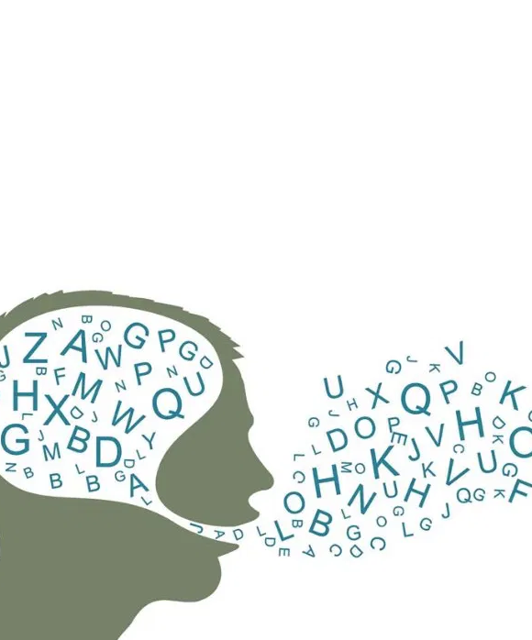
Programming Solutions for Speech Therapy
Ben Lambright

Slide 2
1.
Definitions and Research

Slide 3
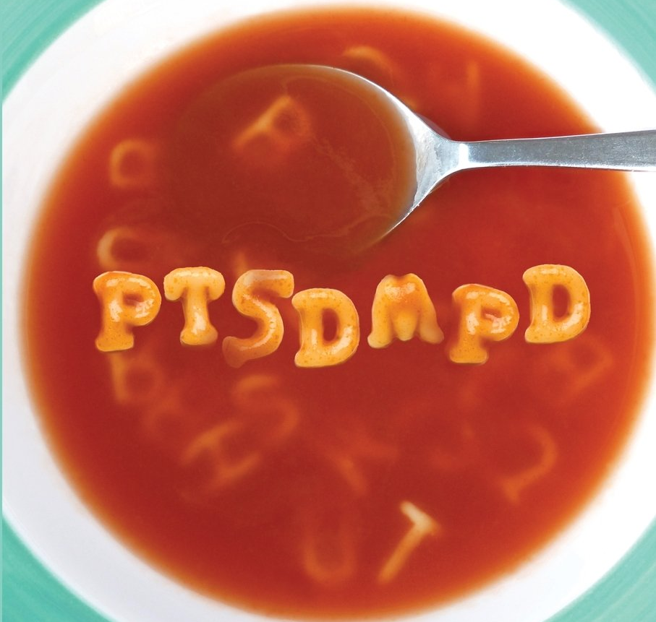
Speech Sound Disorders
The inability to say a speech sound
Notes:
Speech sound disorders are essentially the foundation of my project, so I’m going to have to make sure that you all understand them before we continue.
Most simply, a speech sound disorder is when you cannot say a speech sound.
https://www.asha.org/public/speech/disorders/Speech-Sound-Disorders/

Slide 4
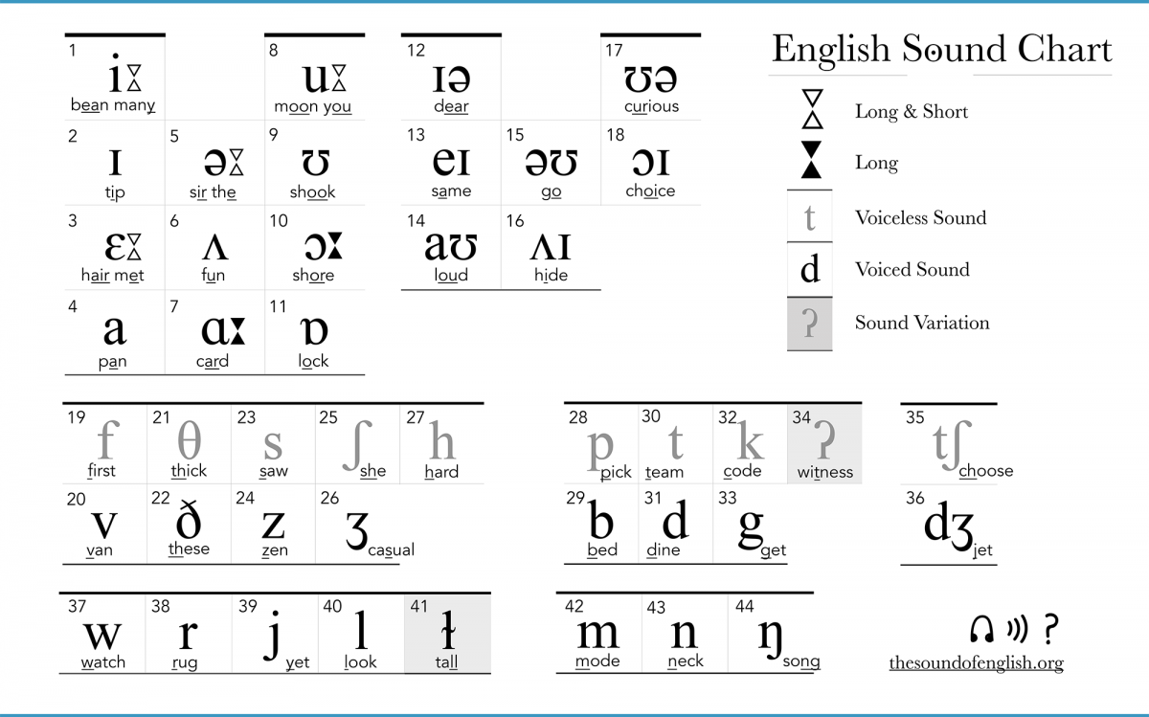
Speech Sounds
The basic sounds that make up language
Notes:
What is a speech sound?
These are the basic building blocks of language
If you are unable to use some of these building blocks of language, it’s going to be a lot harder for people to understand what you are saying.
I’ll talk more about this later, but in short, it’s going to make it harder for someone to learn, have relationships, and basically negatively impact their pursuit of happiness.
https://www.asha.org/public/speech/disorders/Speech-Sound-Disorders/

Slide 5
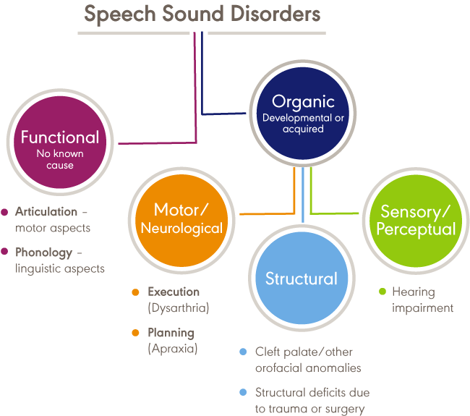
“phonological disorders focus on predictable rule-based errors [in pronunciation]”
Notes:
As you can see, a lot of things fall under the category of speech sound disorders, because there are so many ways for them to occur and work.
Today, we’re only going to focus on one of these, phonological disorders.
As you can see, these fall under the functional speech sound disorders with no known cause.
To quote the American Speech-Language-Hearing Association, “phonological disorders focus on predictable rule-based errors [in pronunciation]”
Let’s go into more detail on this. I can’t see your faces and I know you might still be confused.
https://www.asha.org/Practice-Portal/Clinical-Topics/Articulation-and-Phonology/

Slide 6
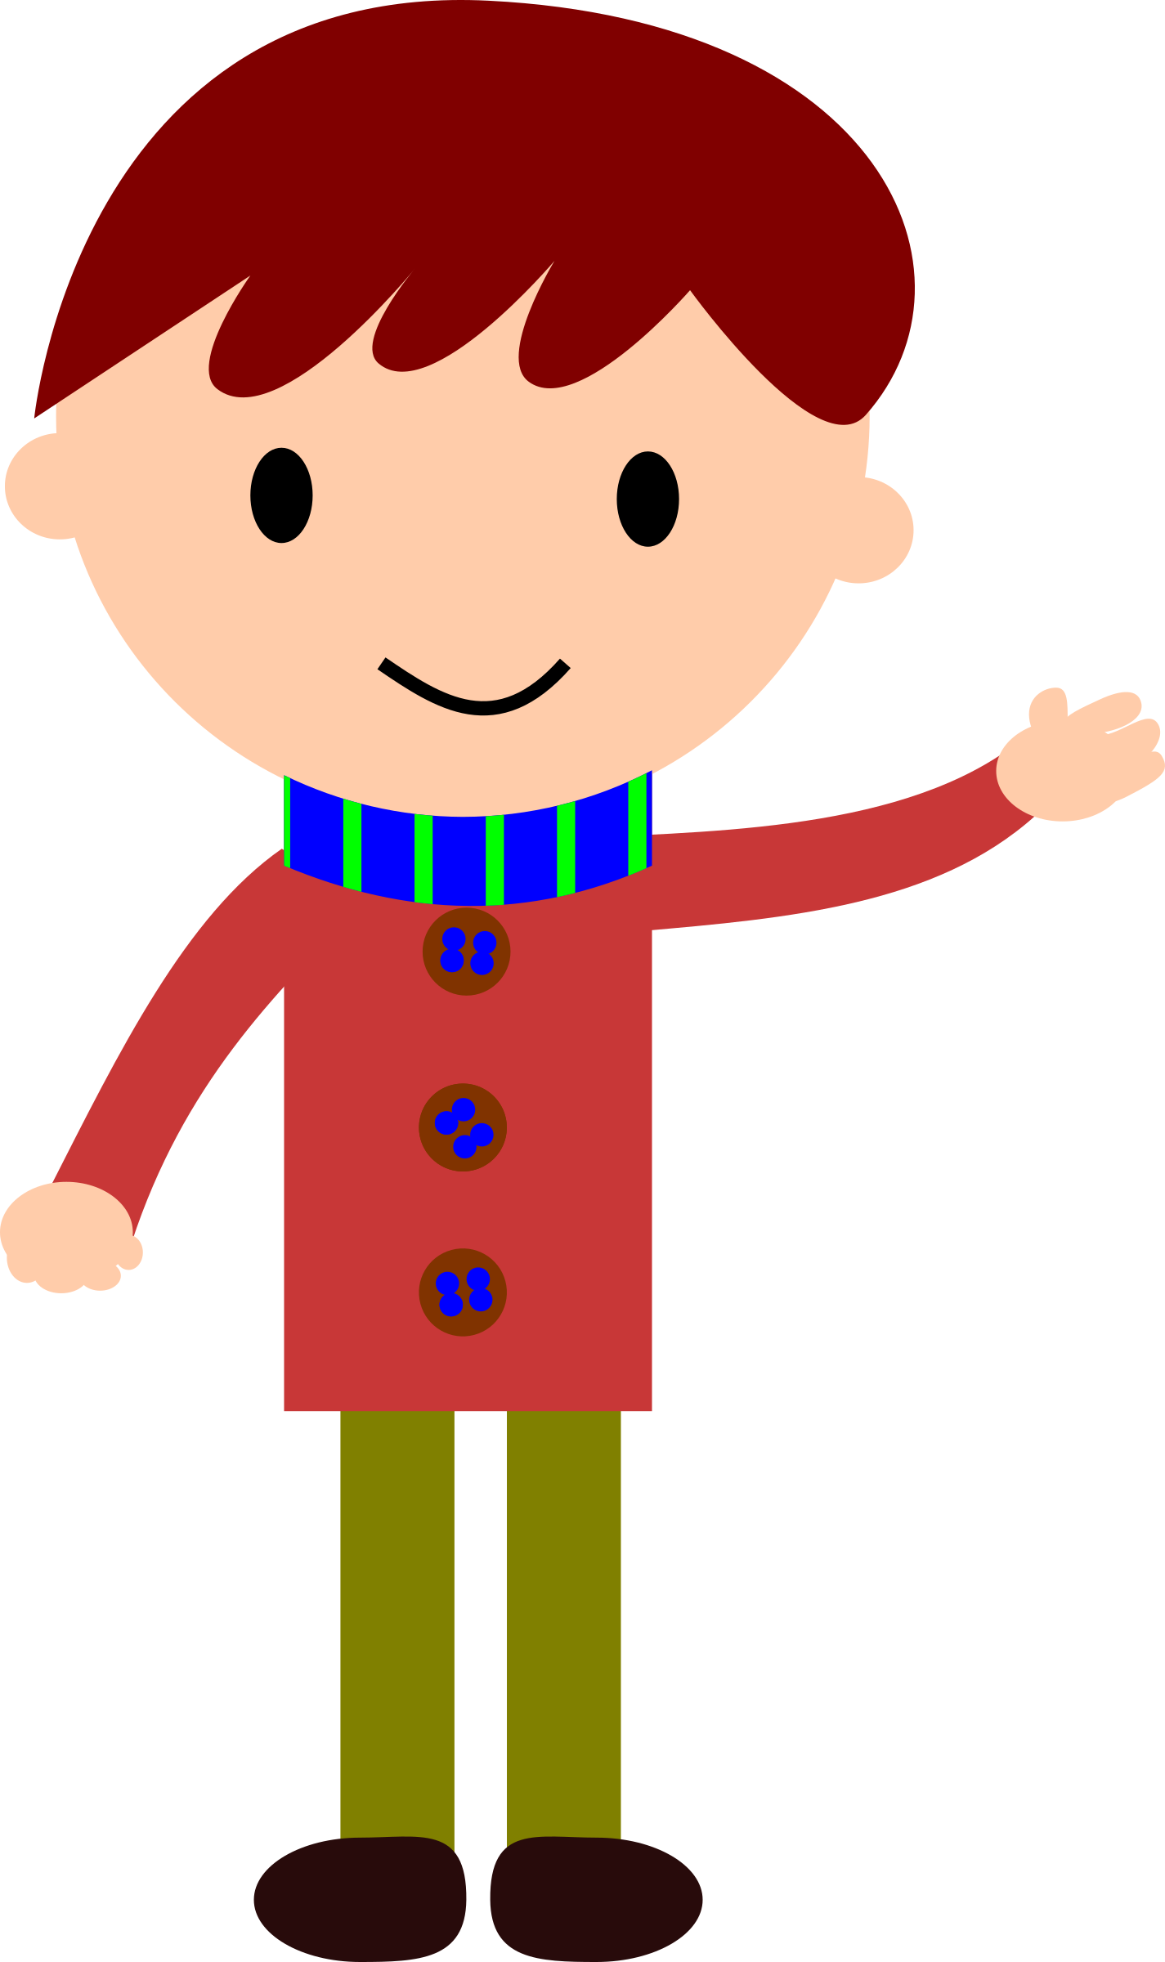
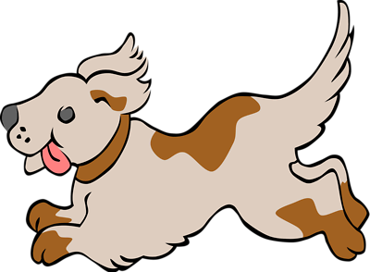
Meet John
Notes:
I think the best way for you to get a basic understanding of phonological disorders in the time is for me to give you an example.
John is a 6 year old who has been in 1st grade for a few months now
His teachers and parents have noticed that he still makes the same mistakes which we all make when we are young: pronouncing car “cah” and dog “gog.”
However, John’s mispronunciations are consistent, unchanging, and some of them, like pronouncing dog “gog” are quite unusual.
Halfway through first grade, John turns seven and still pronounces dog “gog”.
Most of the time, when John tries to say words with consonants pronounced with the tip of his tongue like /d/, he ends up saying sounds farther back in his mouth like /g/.
As this mispronunciation can be so clearly defined, it is called a phonological process. And, as this phonological process shows no sign of changing and could clearly harm his ability to communicate with others and live a happy, normal life, it is a phonological disorder.
http://mommyspeechtherapy.com/?p=2158
https://www.asha.org/public/speech/disorders/Speech-Sound-Disorders/

Slide 7
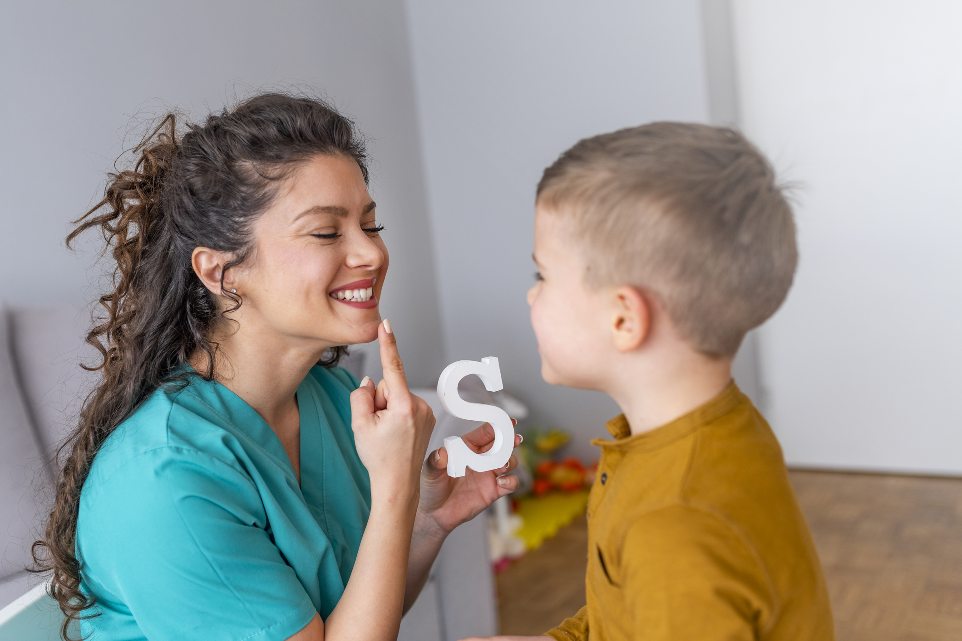
Helping John
Notes:
Now that we know that John has a phonological disorder, how do we help him out?
Fortunately, speech language pathologists, like the one in the picture above, can erase phonological processes from speech with speech therapy.
I interviewed six different speech language pathologists, and I got the same answer from all of them when I asked them what speech therapy actually is
We know the goal, in the case of John it is to eliminate phonological processes, but how it is done is unique to almost every speech language pathologist.
In the example above, for example, I can tell that this speech language pathologist, which I’m going to call SLPs for ease, is trying to show this child how to pronounce the /s/ sound by pointing to the parts of the mouth which produce the sound.
One of most important things just tons of practice. To engage kids like John, they turn therapy into a game, where he is just continuing to practice pronouncing words like dog over and over again until he can confidently do it by himself without even thinking about it.
(info obtained from my interviews)

Slide 8
2.
My Prototype
Notes:
This is where my project comes in
SLPs need to find good words for practicing pronunciation

Slide 9
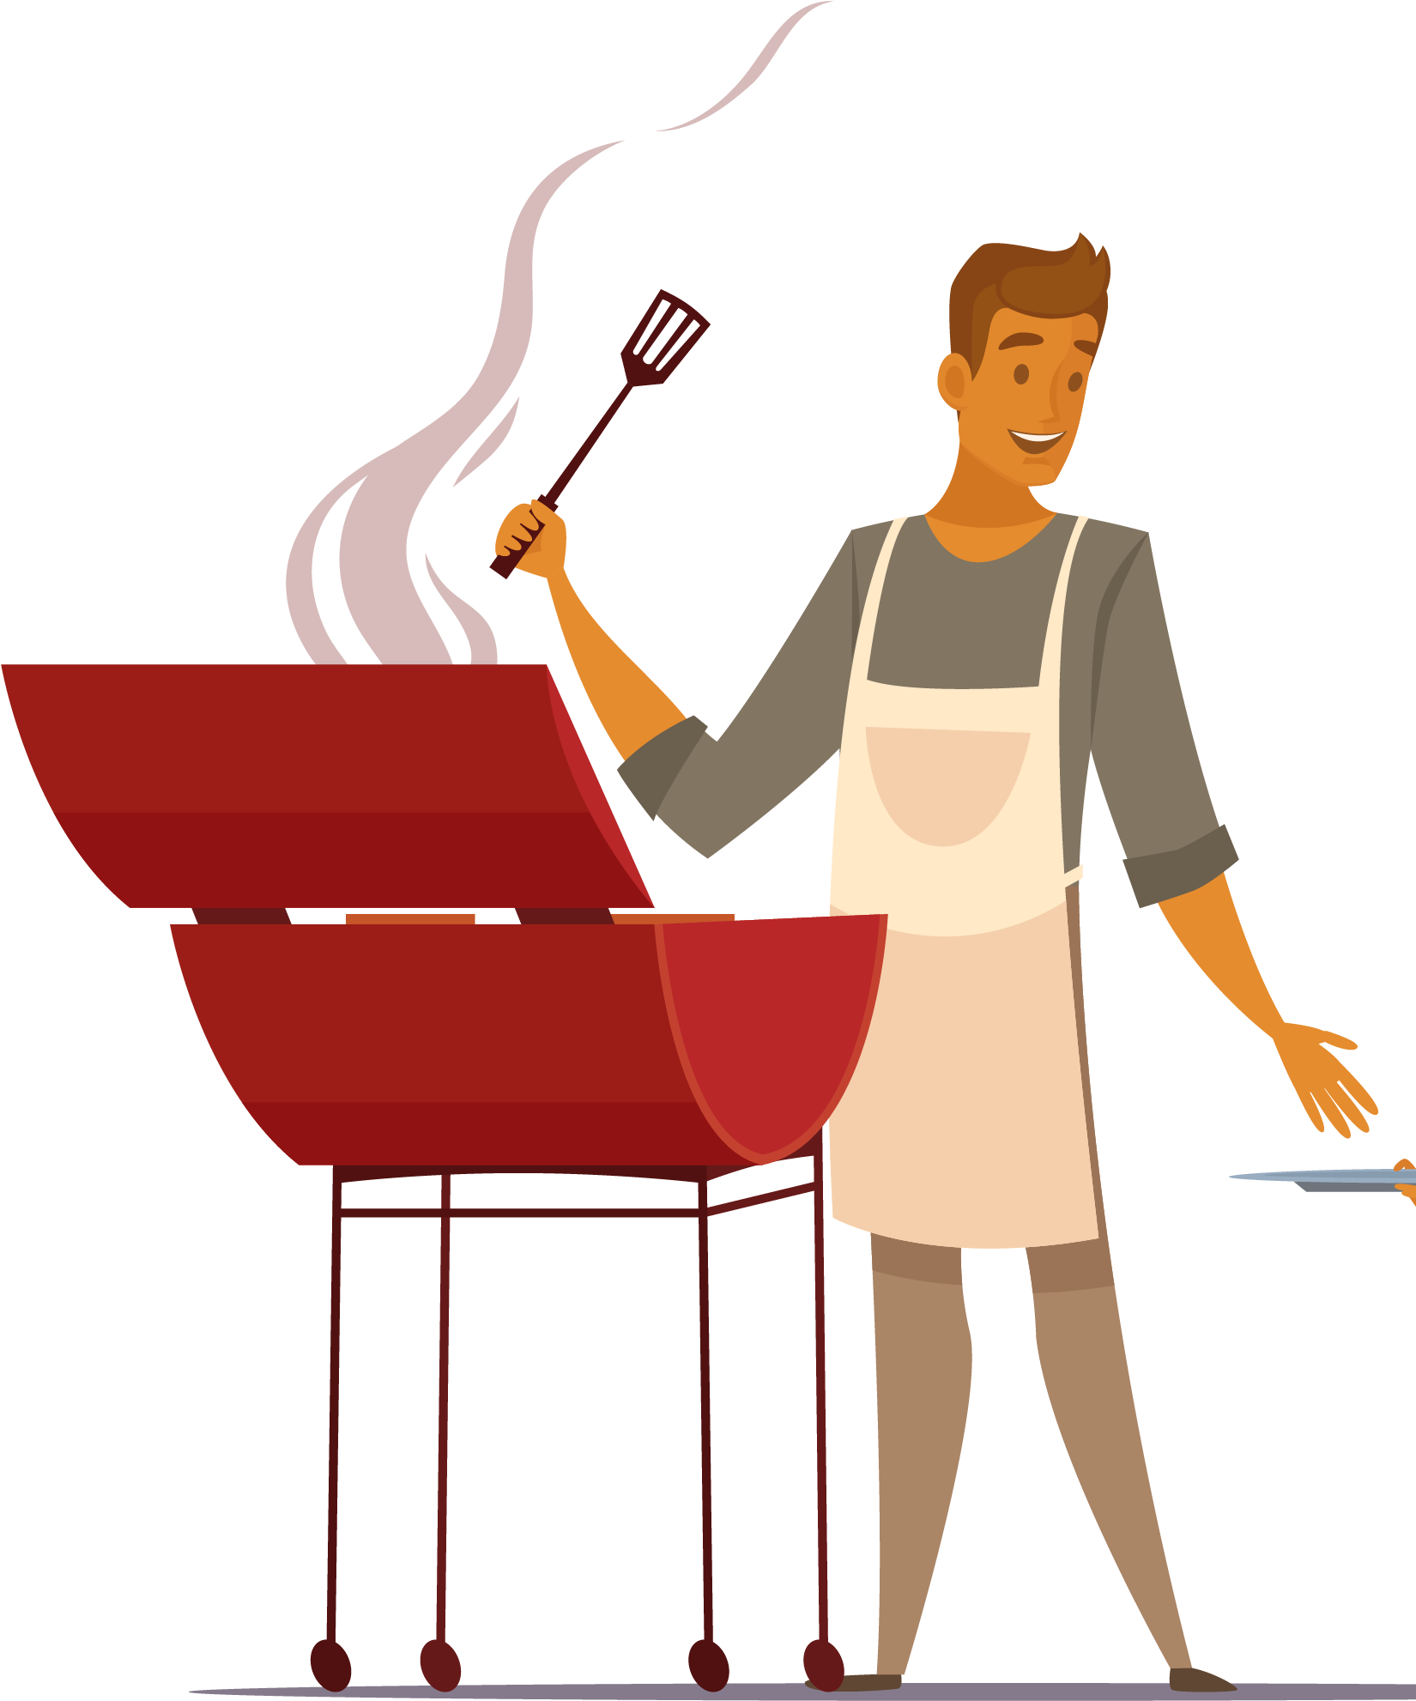
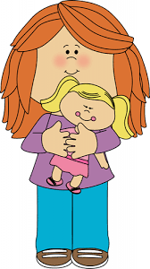
Words similar to “dog”
Requirements:
Fit for the age group
Have a sound like /d/
“doll,” “dad”, “sit”, “tell”, “Ben”
Notes:
So to go back to my example, this is what the SLP would need to do to find words that would help John practice saying dog correctly.
There are two main requirements which my prototype also needs to be able to do
Firstly, the SLP must find words which are suitable for John’s age group (1st grade)
Secondly, they need to have the sounds which John has trouble pronouncing correctly
Sounds produced with the tip of your tongue like the s is snake or the n sound in noodle
These are called the target sounds
I’d also like to not that those slashes next to the d show that I’m talking about the d sound
You’ll see them a lot more as we move on
Here are some example words which the SLP could use aside from just dog.
These are called target words.
I’d like you to notice two things from this list
Firstly, all of the consonants in these words except for /b/ are the target sounds
Secondly, all of these words are one syllable
Three of them follow the pattern consonant vowel consonant.
Those kinds of words are called CVC words and they make great target words.
(info obtained from my interviews)

Slide 10
My Prototype
Notes:
This is basically what my prototype looks like.
It’s a computer program using Python that finds target words for particular phonological processes
I’ll show you a live demonstration momentarily but first I need to explain that first requirement for target words.

Slide 11
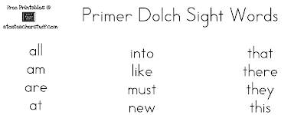
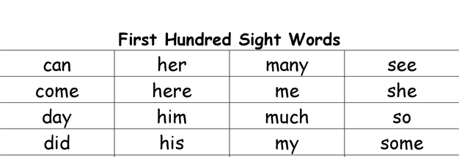
A List of Appropriate Words: “Klist”
445 words
Majority from the Dolch and Fry sight word lists
The remaining are names and characters from children’s tv shows
(Fry)
Notes:
First of all, my program can’t just search the entire English lexicon for words like dog
After talking to SLPs, I realized that finding the right set of words is extremely important
You want words which are easy to pronounce and are hopefully already known to the child
So how did I make my list?
In the last century, people created lists of the most frequent words which we recognize by a quick glance, we don’t need to sound out each letter
These are called sight words
The Dolch and Fry sight word lists are best examples of that and are great for finding age appropriate simple words
Some SLPs I interviewed also recommended names and characters from tv shows, so I threw some of those in there too
“Klist” is just what I call my main list of 445 words
https://www.thoughtco.com/what-are-fry-words-4172325

Slide 12
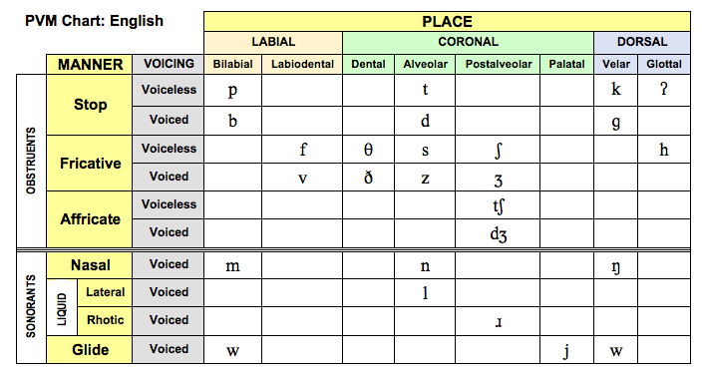
Searching for the Right Sounds
Notes:
Searching for the right sounds are easy if you understand a bit of linguistics
In all of phonological processes my prototype searches for, the error is in articulating the consonant in the wrong place in the mouth or throat
To go back to John, he replaced alveolar sounds like /t/, /d/, and /n/, with velar sounds like /k/, /g/, and /ng/
That’s why this phonological process is called backing, John is moving his tongue much farther back in his mouth than he should.
https://www.asha.org/public/speech/disorders/Speech-Sound-Disorders/

Slide 13
My Phonological Processes
Backing
Fronting
Gliding
Stopping
Vowelization
Affrication
Deaffrication
Alveolarization
Depalatalization
Labialization
Denasalization

Slide 14
Without Further Ado...

Slide 15
3.
Final Thoughts

Slide 16
8-9%
67.6%
48:1
Percentage of young children in the US with speech sound disorders
Percentage of children with these disorders who have received treatment
Median caseload size of students per speech language pathologist
Notes:
So I got these statistics from the NIH and the American Speech-Language-Hearing Association
https://www.nidcd.nih.gov/health/statistics/quick-statistics-voice-speech-language
https://www.asha.org/PRPSpecificTopic.aspx?folderid=8589935321&section=Incidence_and_Prevalencehttps://www.asha.org/uploadedFiles/Schools-2018-SLP-Caseload-and-Workload-Characteristics.pdf

Slide 17
Acknowledgements
Ardith Kirchberger, Amy Lister, and SNHH
Stack overflow
Tim Bilick
Dan Lambright

Slide 18
Sources
(in the speaker notes)
Notes:
Bales, Kris. "What Are Fry Words?" ThoughtCo, Feb. 11, 2020, thoughtco.com/what-are-fry-words-4172325.
Hanks, Heidi. “What Are Phonological Processes?” Thoughts on Speech & Language Development, mommyspeechtherapy.com/?p=2158.
Janota, Jeanette. “2018 Schools Survey: SLP Caseload and Workload Characteristics.” Asha.org,
www.asha.org/uploadedFiles/Schools-2018-SLP-Caseload-and-Workload-Characteristics.pdf.
Kirchberger, Ardith. 18 Mar. 2020.
Lister, Amy. 17 Mar. 2020.
Lucas, Kelsey. 19 Mar. 2020.
“Quick Statistics About Voice, Speech, Language.” National Institute of Deafness and Other Communication Disorders, U.S. Department of Health and Human
Services, 21 Dec. 2017, www.nidcd.nih.gov/health/statistics/quick-statistics-voice-speech-language.
“Speech Sound Disorders.” American Speech-Language-Hearing Association, ASHA, www.asha.org/public/speech/disorders/Speech-Sound-Disorders/.
“Speech Sound Disorders: Articulation and Phonology: Overview.” Speech Sound Disorders: Articulation and Phonology: Overview, ASHA,
www.asha.org/Practice-Portal/Clinical-Topics/Articulation-and-Phonology/.

